Slide 1

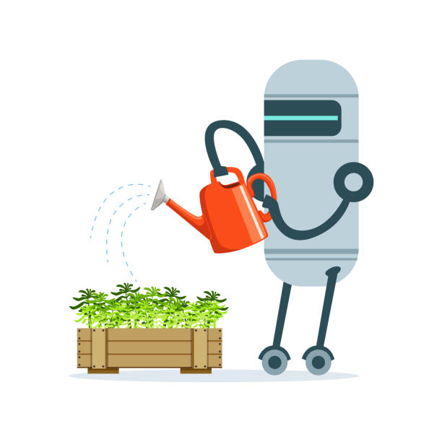

IOT102C - GROUP2
SMART
WATERING
SYSTEM

Slide 2
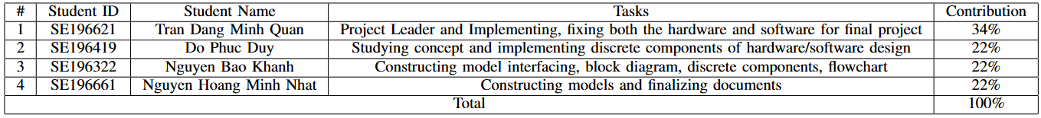
IIOT102C - GROUP2
GROUP 2 MEMBER

Slide 3
INTRODUCTION
IIOT102C - GROUP2
The Smart Watering System automates the process of dispensing water with precision, utilizing components like Arduino, sensors, and a mobile app. It allows users to select the desired amount of water, monitors consumption, and displays progress, enhancing convenience and efficiency in water management.
This project not only enhances user convenience but also promotes efficient water management, making it suitable for various applications, from household use to agricultural settings.
Notes:
Duy

Slide 4
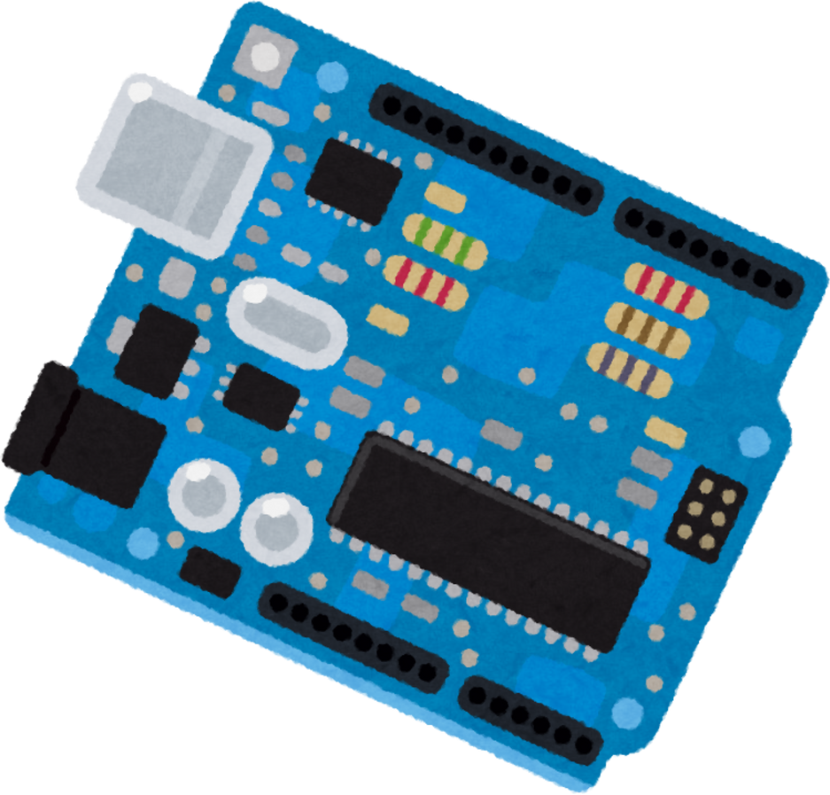



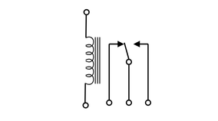


Arduino Uno
Physical Control Panel
User Device
I2C
Water sensor
Relay
Water pump
Watering Zone
Water source

Slide 5

IIOT102C - GROUP2
II. METHOD & MATERIALS

Slide 6
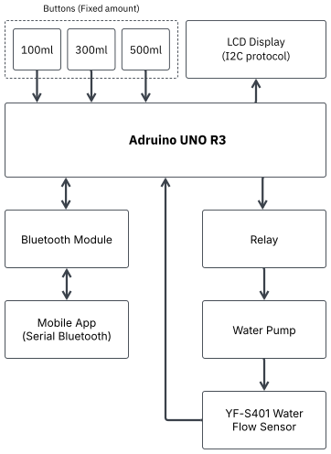
II. METHOD & MATERIALS
A. System Model and Block Diagram
IOT102C - GROUP2

Slide 7


IOT102C - GROUP2
II. METHOD & MATERIALS
Components
Module
Bluetooth
Water
Flow Sensor
Arduino
UNO
3 buttons
Water
Pump
LCD
Screen
Relay
Notes:
thêm ảnh
-công thức water sensor

Slide 8
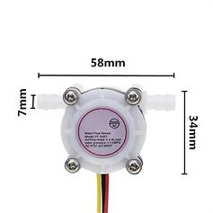
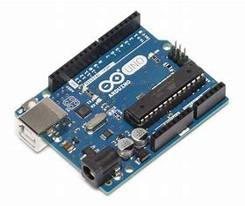
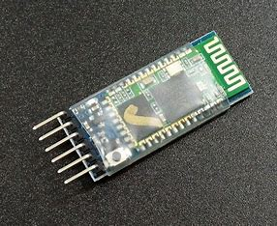
II. METHOD & MATERIALS
IOT102C - GROUP2
B. Components and Peripheral Devices
Module Bluetooth
Description: Wireless communication.
Function: Receives commands from a mobile application.
Usage: Connects to the Arduino RX and TX pins.
Water Flow Sensor
YF S401
Description: Measures water flow rate.
Function: Provides flow rate data.
Usage: Connects to the input pin of the Arduino.
Arduino Uno
Description: Microcontroller board with 14 I/O pins.
Function: Acts as the central controller.
Usage: Connects to a computer via USB.

Slide 9
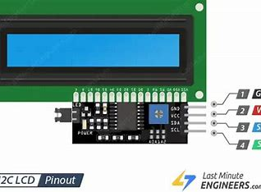
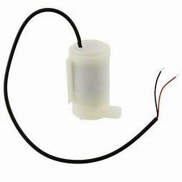
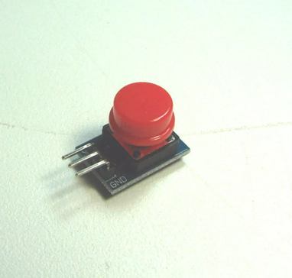
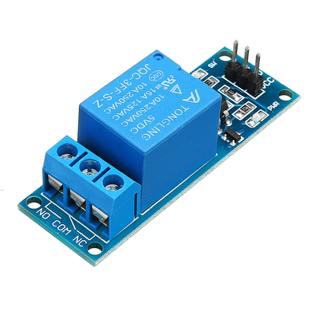
LCD Screen (I2C)
Water Pump
Description: Displays information.
Function: Shows flow rate and status.
Usage: Connects to the Arduino via I2C.
Description: Supplies water.
Function: Provides an accurate water flow.
Usage: Connects to a relay.
II. METHOD & MATERIALS
COMPONENTS
Relay
Buttons
Description: Electrical control device.
Function: Controls the water pump.
Usage: Connects to the output pins of the Arduino
Description: Allows user interaction.
Function: Selects the desired water volume.
Usage: Connects to the input pins of the Arduino.
IOT102C - GROUP2

Slide 10
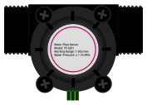

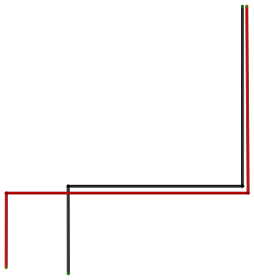

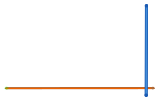

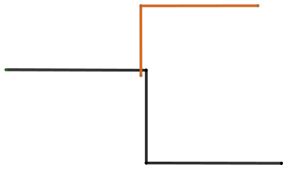

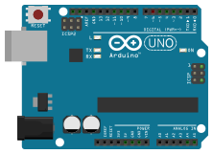
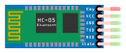
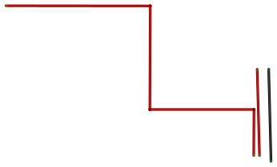

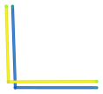
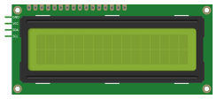


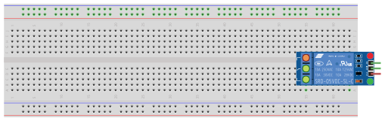

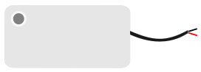



II. METHOD & MATERIALS
Circuit DIAGRAM
IOT102C - GROUP2

Slide 11
IOT102C - GROUP2
Water Flow Measurement System
Hall-Effect Flow Meter
Uses a hall-effect sensor to detect water flow.
Generates electrical pulses proportional to water volume.
Cost-effective, but requires calibration for higher accuracy.
Key Challenge: Accuracy is affected by sensor orientation, fluid pressure, and flow variations.
Notes:
thêm ảnh
-công thức water sensor

Slide 12
IOT102C - GROUP2
III. PARAMETER SETUP
Working Principle
Pulse Generation
Water flow rotates an impeller or turbine inside the sensor.
A Hall-effect sensor detects each rotation and generates square wave pulses.
Each pulse corresponds to 2.25 mL of water.
Flow Rate Calculation
Formula: Q (L/min) = F (Hz) / 7.5
Example: 75 Hz → 10 L/min
Notes:
thêm ảnh
-công thức water sensor

Slide 13
IOT102C - GROUP2
III. PARAMETER SETUP
Working Principle
Water Velocity & Pipe Cross-Sectional Area
The flow rate (Q) can also be derived from water velocity (V) and pipe area (A):
Q(m3/s)=A(m2)×V(m/s)Q (m^3/s) = A (m^2) × V (m/s)Q(m3/s)=A(m2)×V(m/s)
Conversion to L/min:
1m3/s=60,000L/min1 m^3/s = 60,000 L/min1m3/s=60,000L/min
Total Water Volume Calculation
Total water volume passing through the sensor over time t (seconds):
Volume(L) = Total Pulses / (7.5 × 60)
Example: 4,500 pulses in 60 seconds → 10 L.
Notes:
thêm ảnh
-công thức water sensor

Slide 14
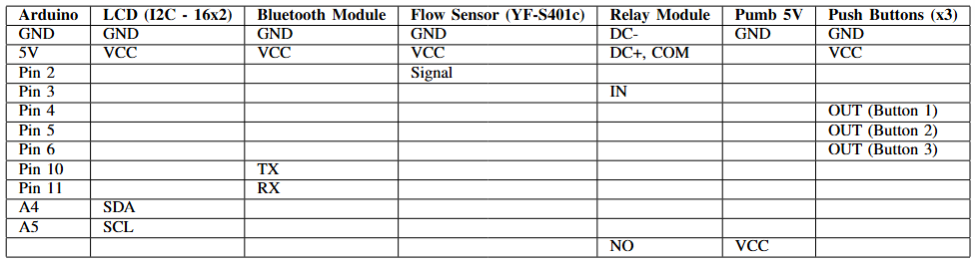
II. METHOD & MATERIALS
INTERFACING BETWEEN ARDUINO UNO AND ITS COMPONENTS
Notes:
KHÁNH

Slide 15
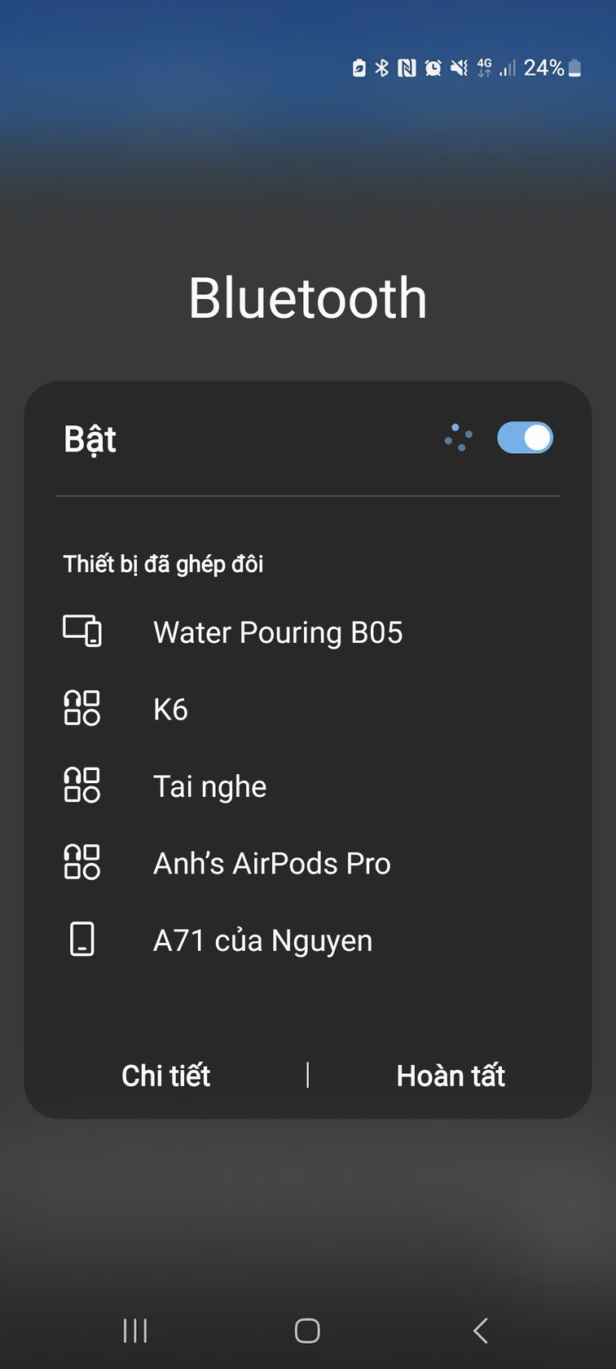
II. METHOD & MATERIALS
Bluetooth Serial Connection Implementation
Step 1: Enable Bluetooth on Mobile
→ Turn on Bluetooth in device settings (Settings → Bluetooth).
Notes:
KHÁNH

Slide 16
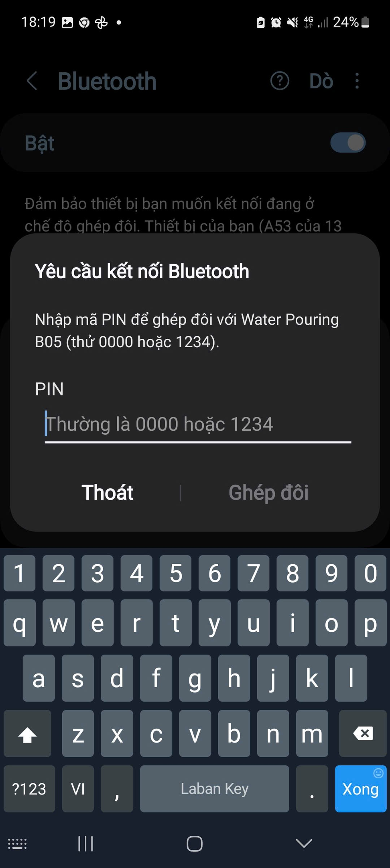
II. METHOD & MATERIALS
Bluetooth Serial Connection Implementation
Step 2: Pair with HC-05 Module
→ Search for "Water Pouring B05", tap to pair, and enter PIN 1234 or 0000.
Notes:
KHÁNH

Slide 17
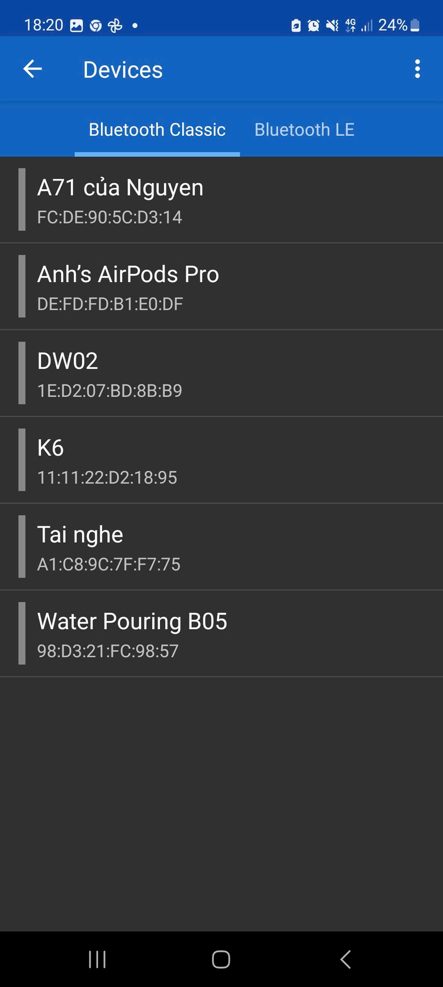
II. METHOD & MATERIALS
Bluetooth Serial Connection Implementation
Step 3: Establish Connection
→ In a Bluetooth terminal app, select HC-05 and tap "Connect".
Notes:
KHÁNH

Slide 18
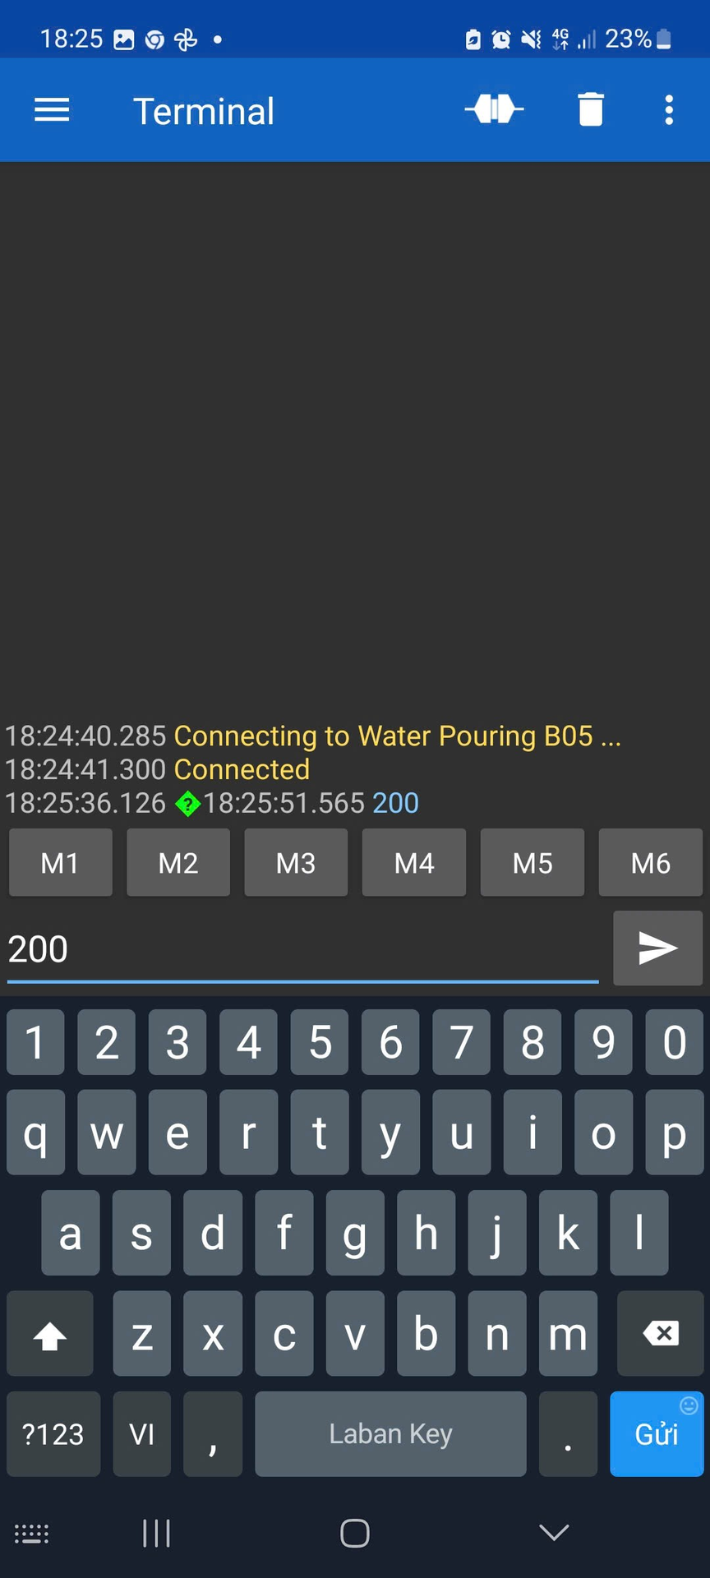
II. METHOD & MATERIALS
Bluetooth Serial Connection Implementation
Step 4: Send Data to Arduino
→ Type a number (e.g., 100) in the app and press "Send".
Notes:
KHÁNH

Slide 19
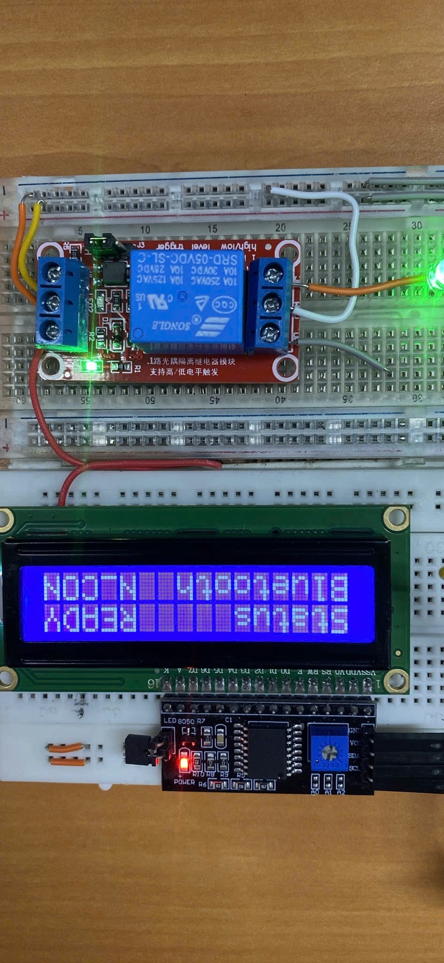
II. METHOD & MATERIALS
Bluetooth Serial Connection Implementation
Step 5: Verify Communication
→ Check the Arduino Serial Monitor (9600 baud rate) for received data. If issues occur, verify baud rate & wiring.
Notes:
KHÁNH

Slide 20
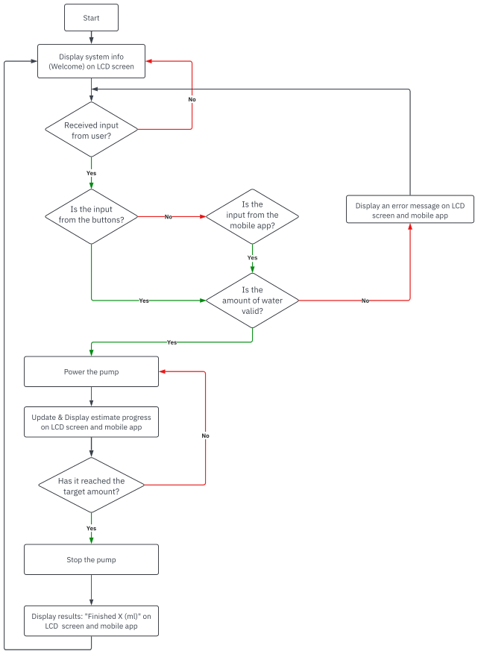
II. METHOD & MATERIALS
PROGRAMING FLOWCHART
IOT102C - GROUP2

Slide 21
II. METHOD & MATERIALS
PROGRAMING FLOWCHART
Step 1: System Initialization & LCD Activation
System starts, verifying connections (LCD, sensor, relay, Bluetooth).
Displays system information for 650ms.
LCD shows "SYSTEM READY" when initialization is complete.
Step 2: User Input Reception & Validation
Receives input from buttons or mobile app.
Validates water volume (100-2000mL).
If invalid → displays error on LCD and app.
Notes:
thêm ảnh
-công thức water sensor

Slide 22
II. METHOD & MATERIALS
PROGRAMING FLOWCHART
Step 3: Pump Activation & Flow Control
If valid → activates pump via relay.
Hall-effect sensor counts pulses, measuring water flow.
PID control adjusts pump speed for accuracy.
Step 4: Real-Time Progress Monitoring
LCD and app display progress percentage.
Updates volume every 50ms, estimates remaining time.
Notes:
thêm ảnh
-công thức water sensor

Slide 23
II. METHOD & MATERIALS
PROGRAMING FLOWCHART
Step 5: Target Volume Verification & Pump Shutdown
At 98% target → gradually slows pump over 300ms.
Stops pump precisely at 100%, preventing backflow.
Step 6: Final Display & Data Reporting
LCD & app show final volume (e.g., "FINISHED 487mL").
Saves transaction to EEPROM & sends confirmation via Bluetooth.
Step 7: Continuous Operation Cycle
Stops pump, prevents overflow, and displays completion message.
After 5 seconds, the system returns to standby mode, ready for the next input.
Notes:
thêm ảnh
-công thức water sensor

Slide 24

IIOT102C - GROUP2
III. RESULTS AND DISCUSSION

Slide 25

DISCUSSION - ADVANTAGES
±10% accuracy in volume measurement.
Dual control: Physical buttons & Bluetooth app.
Energy-efficient pump operation.
Low production cost (<$50), making it ideal for small-scale beverage, lab, and agricultural applications.

Slide 26

DISCUSSION - DISADVANTAGES
Corrosion-resistant materials for durability.
Temperature compensation for accurate viscosity-based measurement.
Bluetooth 5.0 for extended wireless range.
Smart features: Usage analysis & predictive maintenance.

Slide 27
III. RESULTS AND DISCUSSION
CONCLUSION
=> This project lays a strong foundation for next-gen liquid handling systems, ensuring adaptability for commercial & industrial applications, with a cost-effective & user-friendly design ready for potential commercialization.
Notes:
thêm ảnh
-công thức water sensor

Slide 28




IOT102C - GROUP2
THANK YOU
FOR YOUR ATTENTION

